Slide 1
Introduction to
Flow Matching
Diffusion Seminar (Week11)
Woojin Kim
AIDAS LAB
Seoul National University
wjk9904@snu.ac.kr

Slide 2
Table of contents
1
Generative Modeling
2
Normalizing Flows
3
Flow Matching
4
Rectified Flow
5
Relation to Diffusion Models

Slide 3
Recap: Generative Modeling

Slide 4
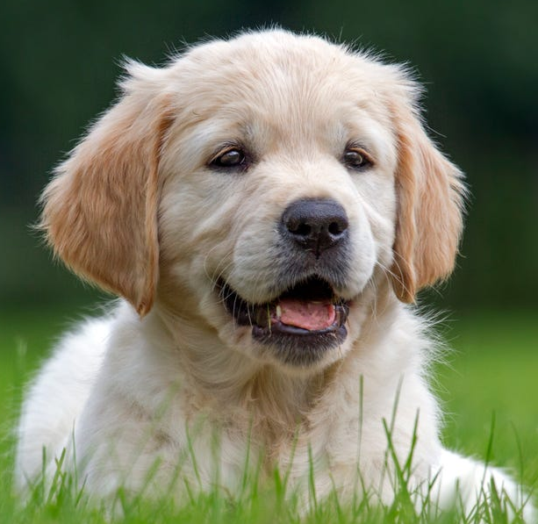
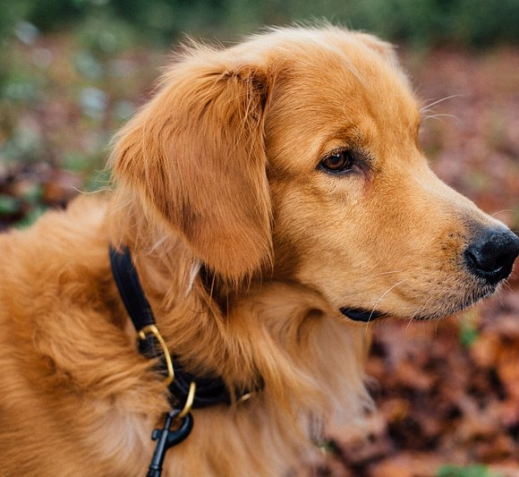
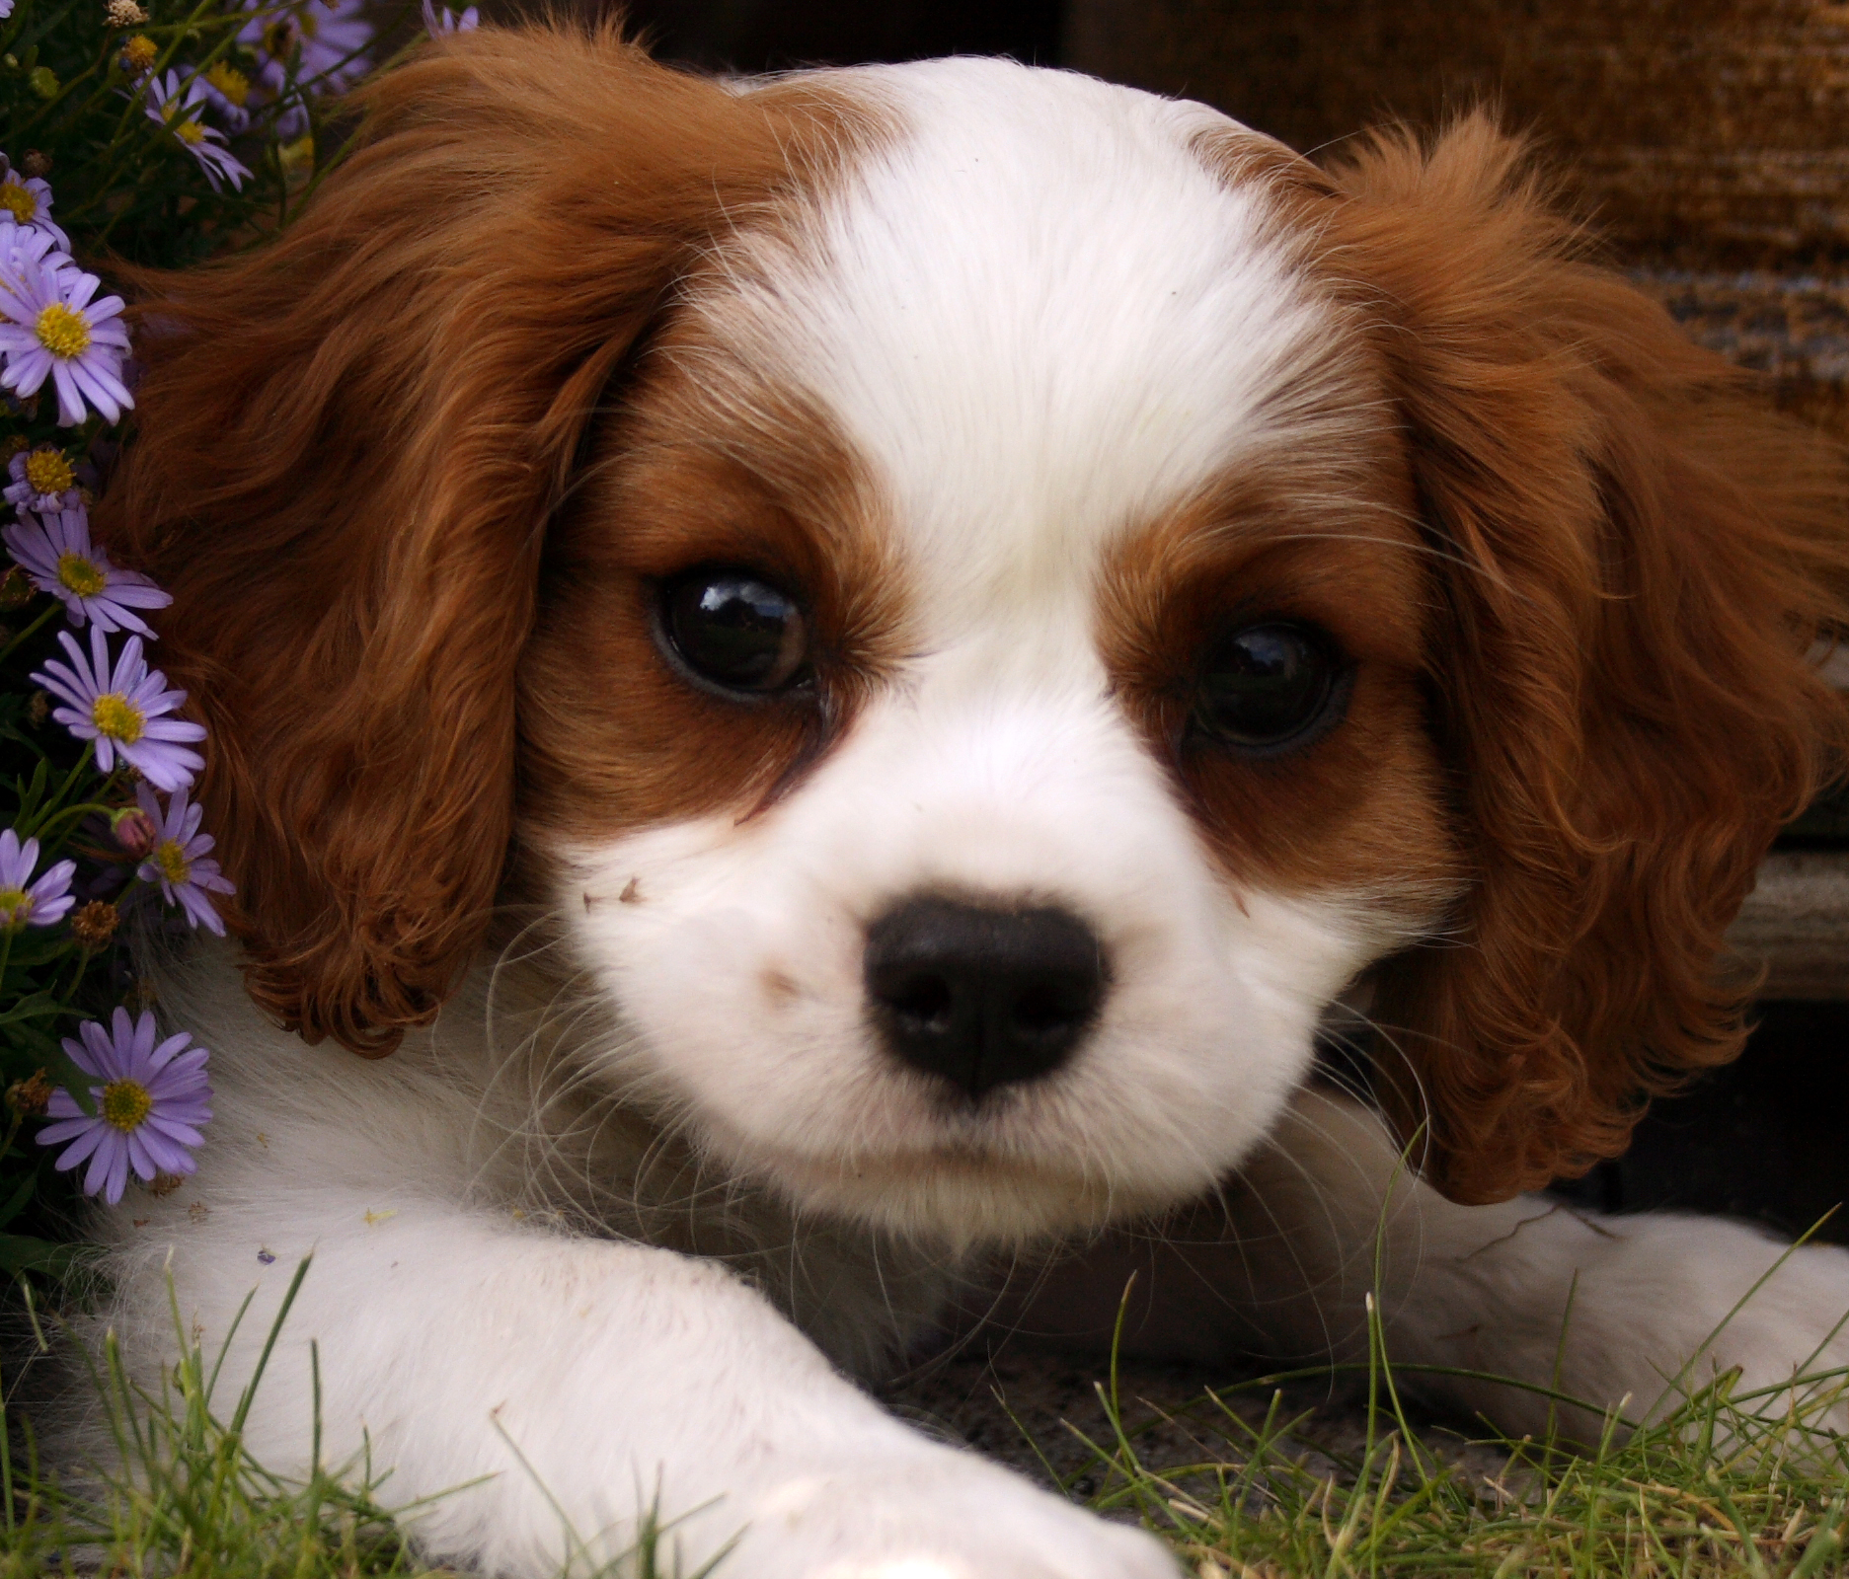
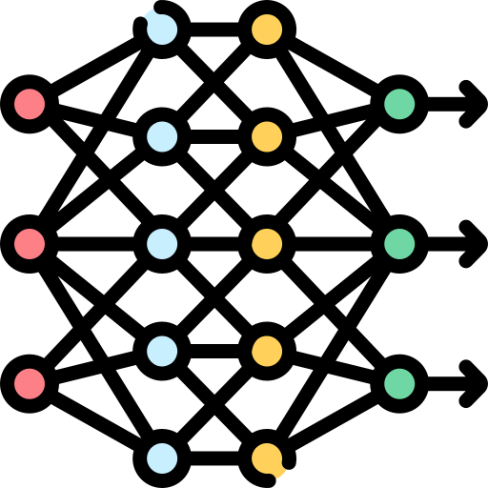
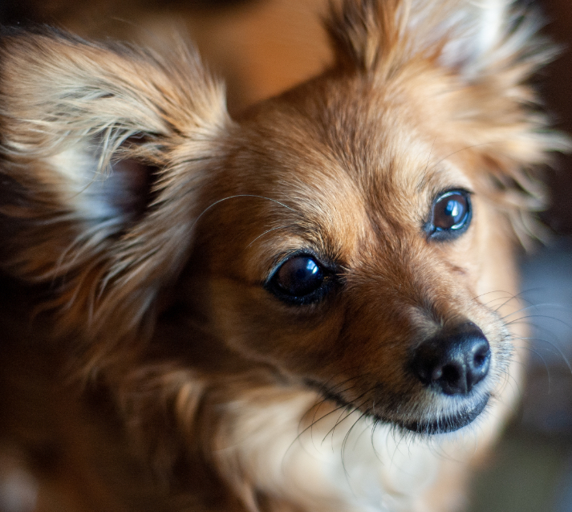
Deep Generative Models
1. Generative Modeling
Generative Models: Models that learn data patterns to generate new, realistic examples.
Objective: To train a model $p(x)$ that approximates the true data distribution $P_{data}(x)$
True Data Distribution
Sampled Data Distribution
Neural Networks
???
Sample
Train
Generate
Image source: Freepik from Flaticon

Slide 5
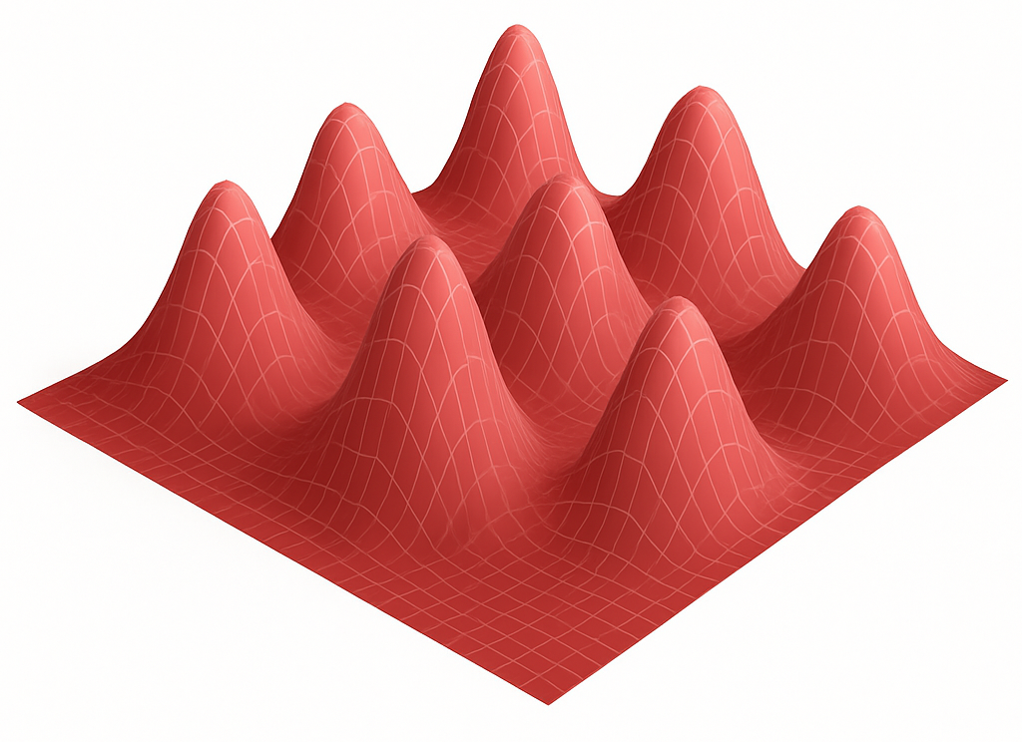
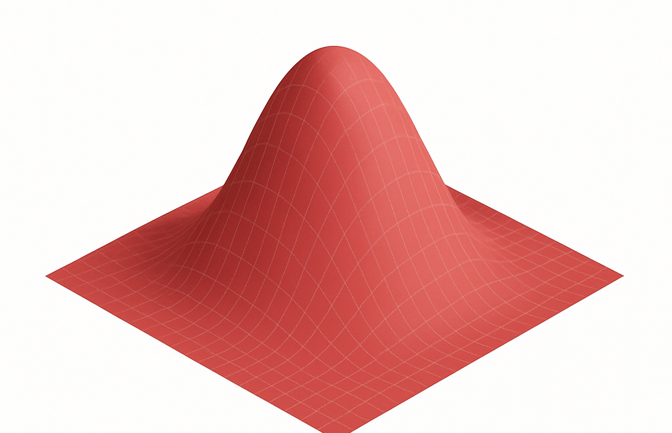
Deep Generative Models
1. Generative Modeling
Even though we can sample data, we want to train a model that learns to generate it
However, this is hard because:
Real data lies in a high-dimensional, complex space
We usually start from a simple distribution (like a standard Gaussian)
Learning the transformation from a simple latent space to real data is non-trivial
Complex data distribution
Simple prior
learning direct transformation
is hard

Slide 6
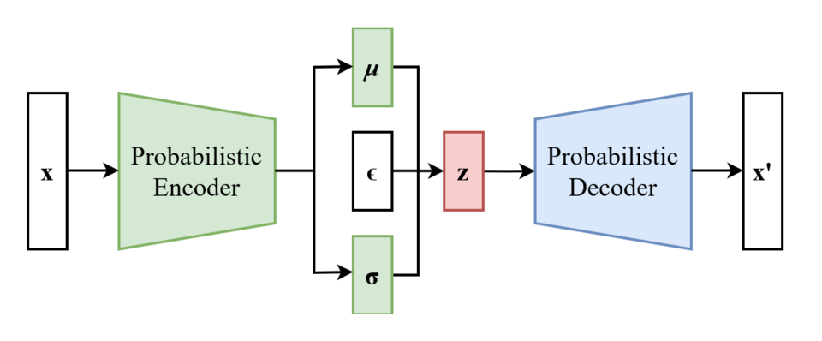
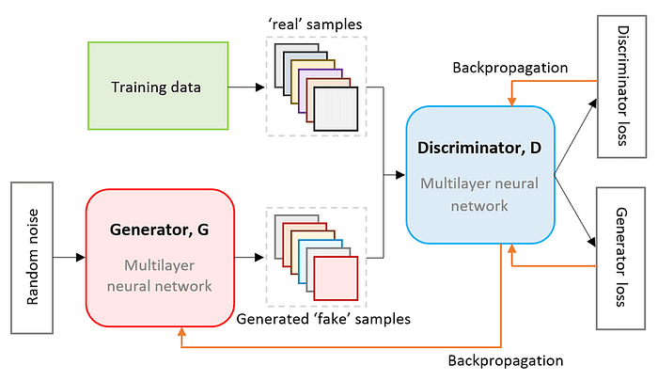
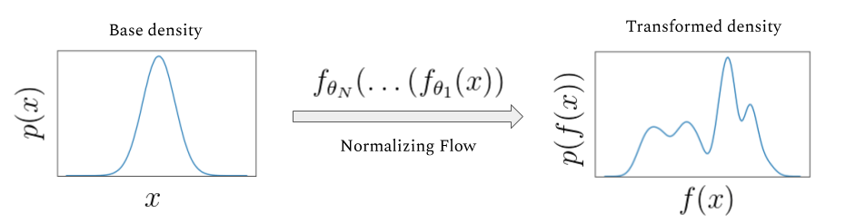
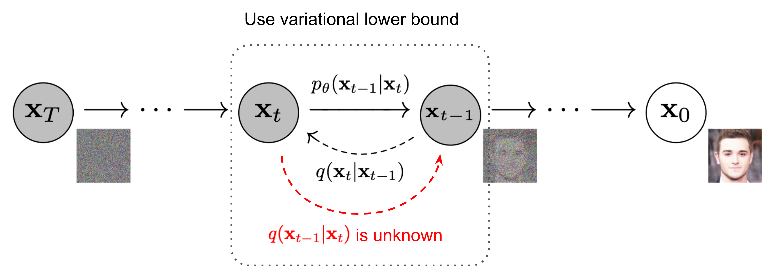
Deep Generative Models
1. Generative Modeling
VAE (Kingma & Welling, 2013)
GAN (Goodfellow et al., 2014)
https://commons.wikimedia.org/wiki/File:Reparameterized_Variational_Autoencoder.png
https://arxiv.org/abs/2112.01925
Normalizing Flow (Rezende & Mohamed, 2015)
Diffusion Model (Ho et al., 2020)
https://siboehm.com/articles/19/normalizing-flow-network
https://arxiv.org/abs/2006.11239

Slide 7
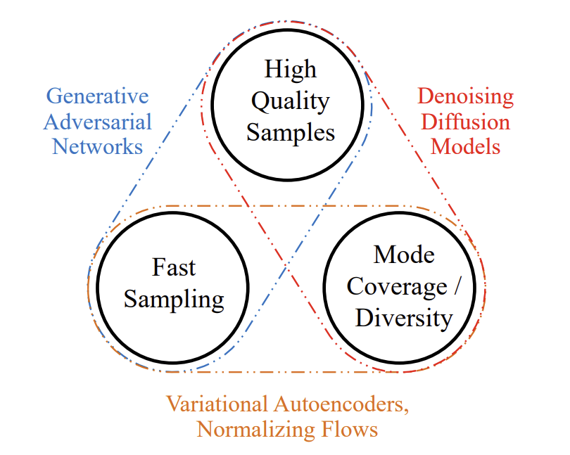
Generative Learning Trilemma
1. Generative Modeling
Image credit: Xiao et al., “Tackling the generative learning trilemma with denoising diffusion gans”, ICLR 2022.

Slide 8
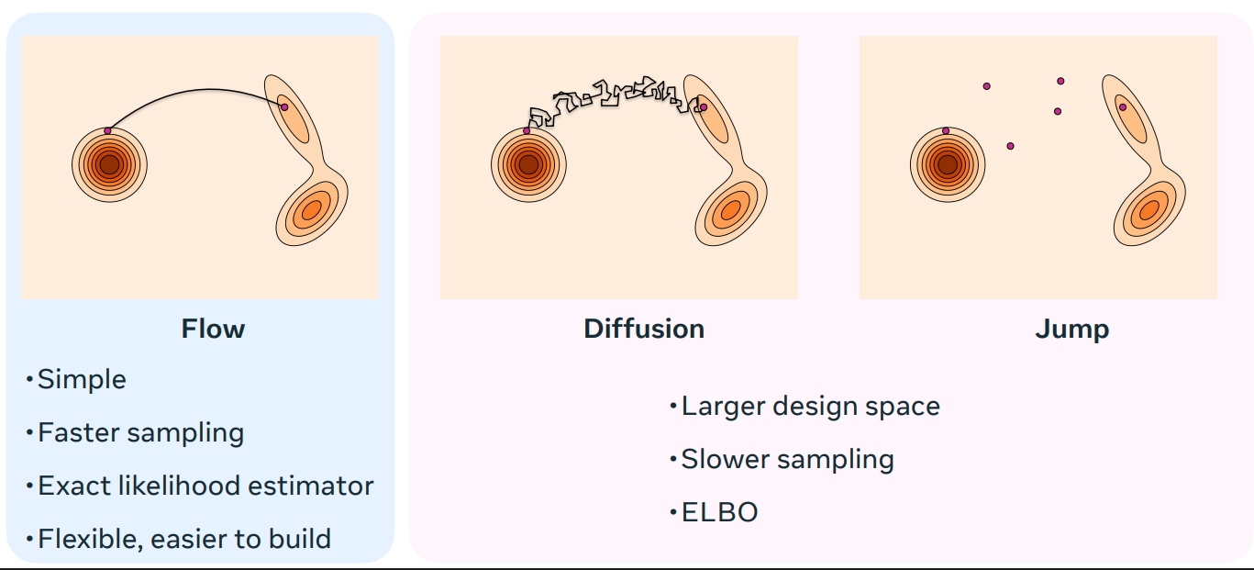
Generative Learning Trilemma
1. Generative Modeling
Image credit: Chen et al., “Flow Matching for Generative Modeling”, NeurIPS Tutorial, 2024.

Slide 9
Normalizing Flows

Slide 10
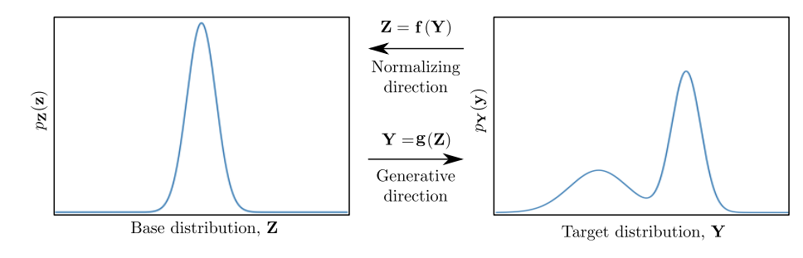
Normalizing Flows
2. Normalizing Flows
For two distributions $X$ and $Z$, under suitable conditions, there exists a differentiable and invertible transformation that maps $Z$ to $X$ (see Brenier’s theorem for details).
Given a complex data distribution 𝑋 and a simple base distribution 𝑍, one can construct a transformation f that pushes 𝑍 forward into 𝑋.
The goal of normalizing flows is to learn such a transformation f in a parameterized form
Rezende et al., “Variational Inference with Normalizing Flows”, ICML 2016.
Kobyzev et al., “Normalizing Flows: An Introduction and Review of Current Methods”, IEEE TPAMI 2020.

Slide 11


What is a Flow?
2. Normalizing Flows
A flow is a continuous and invertible transformation between distributions.
Probability transformation rule:
$$p_{X}\left(x\right)=p_{X}(f\left(x\right))\left|\det{\frac{∂f(x)}{∂x}}\right|$$
Flow is composed of a sequence of transformations:
$$f=f_{K}∘f_{K=1}∘…∘f_{1}$$
Each step 𝑓𝑖​ is chosen so the Jacobian determinant is tractable.
Rezende et al., “Variational Inference with Normalizing Flows”, ICML 2016.
Kobyzev et al., “Normalizing Flows: An Introduction and Review of Current Methods”, IEEE TPAMI 2020.

Slide 12




Continuous Normalizing Flow
2. Normalizing Flows
Normalizing flow with finite sequence (discrete time)
$$f=f_{K}∘f_{K=1}∘…∘f_{1}$$
$$As K→∞,$$
we obtain a continuous-time flow governed by an ODE:
$$\frac{dz(t)}{dt}=f_{ θ}(z\left(t\right), t)$$
$$=v\left(z\left(t\right), t\right) :Velocity field$$
$$z\left(T\right)=z\left(0\right)+ \int_{0}^{T}{v\left(z\left(t\right), t\right) dt}$$
Chen et al., “Neural Ordinary Differential Equations”, NeurIPS 2018.

Slide 13



Training
2. Normalizing Flows
Log-likelihood for the data:
$$\log{p_{X}\left(z\left(T\right)\right)=\log{p_{X}\left(x\right)} }$$
With instantaneous change-of-variables:
$$\frac{d}{dt}\log{p\left(z(t\right))=−Tr (\frac{∂v_{θ}}{∂z\left(t\right)})}$$
This means that this integral should be calculated for every train step
$$\log{p_{X}\left(z\left(T\right)\right)=\log{p_{Z}\left(z(0)\right)} − \int_{0}^{T}{Tr \left(\frac{∂v_{θ}}{∂z\left(t\right)}\right)dt}}$$
We should maximize this
Chen et al., “Neural Ordinary Differential Equations”, NeurIPS 2018.

Slide 14
Flow Matching

Slide 15


Flow Matching Objective
3. Flow Matching
Limitation of CNF
Training requires solving ODE for every data point.
Heavy & Slow
Must integrate the trace of Jacobian along the whole path
Flow Matching
Instead of training with full likelihood + trace integral,
Flow Matching directly trains the velocity field
$$v_{θ}\left(z, t\right)$$
First define a family of interpolating distributions between base $p_{Z}$ and the data $p_{X}$
Then, we can get the true velocity as:
$\frac{dz_{t}}{dt}$ = $v_{θ}\left(z, t\right)$
Lipman et al., “Flow Matching for generative modeling”, ICLR 2023.

Slide 16
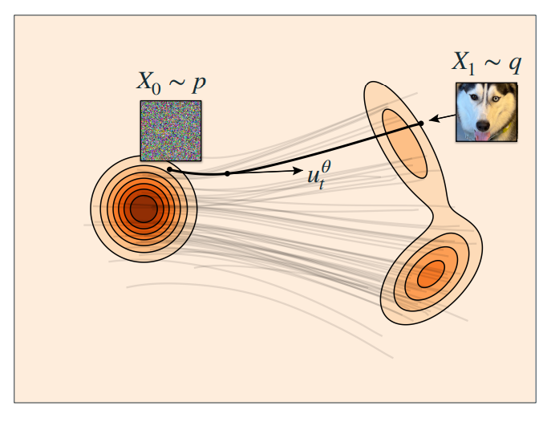
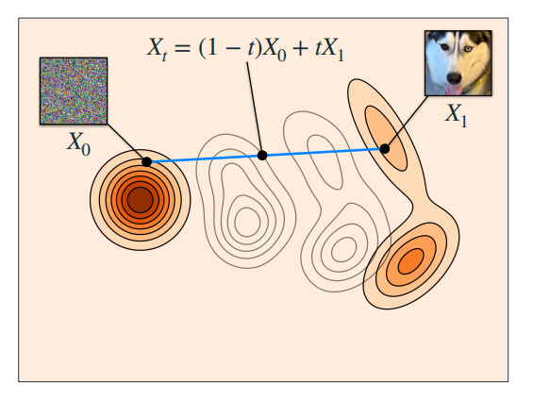
Flow Matching Objective
3. Flow Matching
Training objective is simple:
$$L_{FM}\left(θ\right)=E_{t,x,z_{0} } {\left\|v_{θ}\left(z,t\right)−v_{true}(z,t)\right\|}^{2}$$
Image credit: Chen et al., “Flow Matching for Generative Modeling”, NeurIPS Tutorial, 2024.

Slide 17
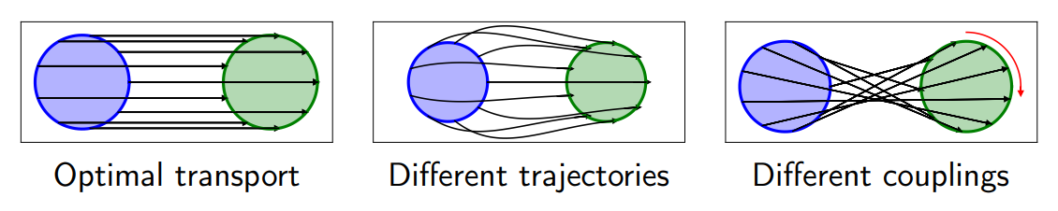
Flow Transport
3. Flow Matching
There might exist several possible mapping from latent distribution to target data distribution
Transport Process: stochastic process that maps $Z_{0} (latent)$ to $Z_{1} (data)$
Transport Plan (Coupling): Joint distribution between start-end pairs ($Z_{0} ,Z_{1})$
Transport Map: Deterministic mapping such that $Z_{1}=T(Z_{0})$
qiang liu., “Flowing Through Continuous-Time Generative Models: A Clear and Systematic Tour”, ICML Tutorial 2025.

Slide 18
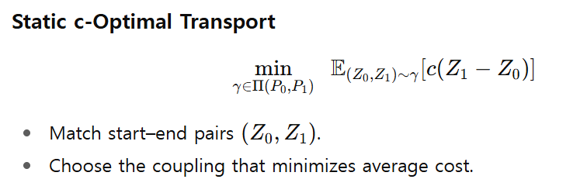
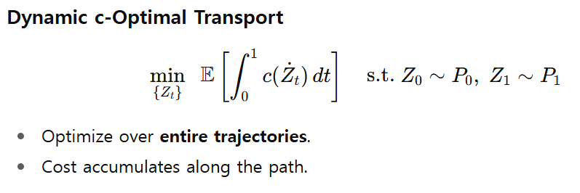
Optimal Transport
3. Flow Matching
How do we choose the best mapping between two distributions?
Introduce a cost function $c$ that measure transport effort
Optimal transport: The transport plan (or map) that minimizes expected cost.

Slide 19
Rectified Flow

Slide 20
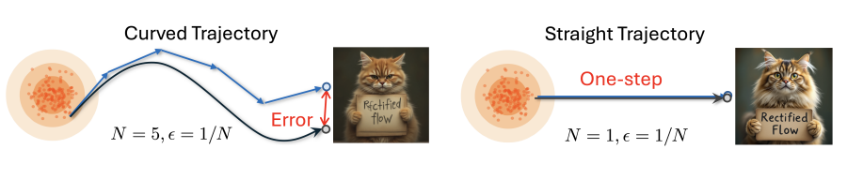
Enforcing Straightness
4. Rectified Flow
We often solve transport ODEs by discretization (e.g., Euler’s method)
When the transport path has high curvature, numerical solvers may accumulate large errors
The fastest and simplest path is just a straight line interpolation between start and end points.
Rectified Flow: directly trains the model to follow this straight path, avoiding unnecessary curvature.
qiang liu., “Flowing Through Continuous-Time Generative Models: A Clear and Systematic Tour”, ICML Tutorial 2025.

Slide 21
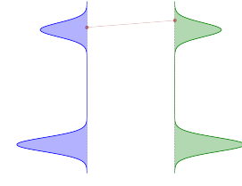
Rectified Flow
4. Rectified Flow
Coupling: Sample from a noise-data pair ($Z_{0}, Z_{1}$)
qiang liu., “Flowing Through Continuous-Time Generative Models: A Clear and Systematic Tour”, ICML Tutorial 2025.

Slide 22
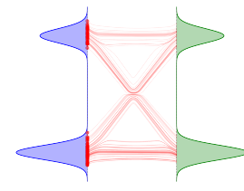



Rectified Flow
4. Rectified Flow
Coupling: Sample from a noise-data pair ($Z_{0}, Z_{1}$)
Interpolation:
$$Z_{t}=tZ_{1}+\left(1−t\right)Z_{0}$$
Marginal Matching:
$\frac{d}{dt}Z_{t}=Z_{1}−Z_{0}$
$$L_{RF}=E_{Z_{0}, Z_{1},t}{\left\|v_{θ}\left(z,t\right)−(Z_{1}−Z_{0})\right\|}^{2}$$
qiang liu., “Flowing Through Continuous-Time Generative Models: A Clear and Systematic Tour”, ICML Tutorial 2025.

Slide 23
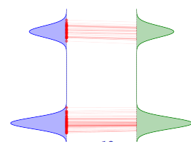
Rectified Flow
4. Rectified Flow
Coupling: Sample from a noise-data pair ($Z_{0}, Z_{1}$)
Interpolation:
$$Z_{t}=tZ_{1}+\left(1−t\right)Z_{0}$$
Marginal Matching:
$\frac{d}{dt}Z_{t}=Z_{1}−Z_{0}$
$$L_{RF}=E_{Z_{0}, Z_{1},t}{\left\|v_{θ}\left(z,t\right)−(Z_{1}−Z_{0})\right\|}^{2}$$
Reflow: With updated vector field, obtain new couplings via ODE -> Repeat
qiang liu., “Flowing Through Continuous-Time Generative Models: A Clear and Systematic Tour”, ICML Tutorial 2025.

Slide 24
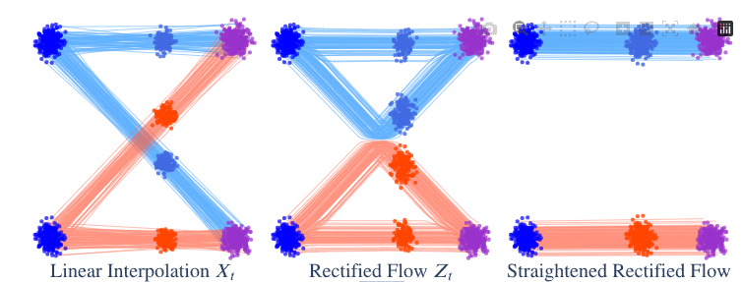
Rectified Flow
4. Rectified Flow
Note that ODE paths cannot intersect (marginal matching rewires the path)
Reflow straightens the flow path
qiang liu., “Flowing Through Continuous-Time Generative Models: A Clear and Systematic Tour”, ICML Tutorial 2025.

Slide 25
Relation to Diffusion Models

Slide 26
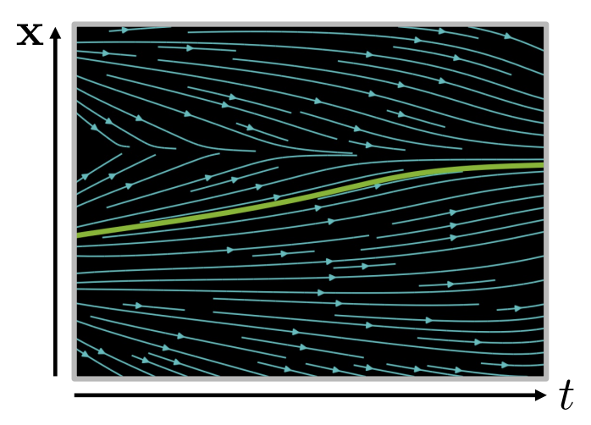
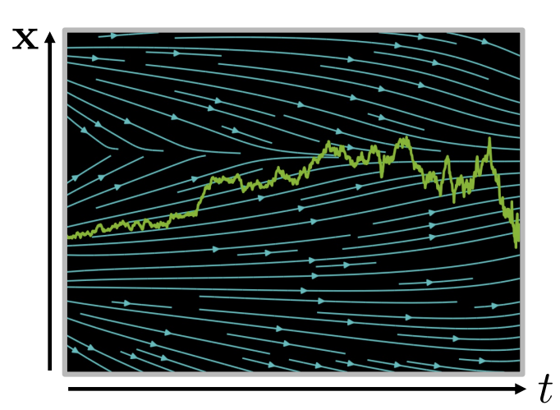


ODE & SDE
5. Relation to Diffusion Models
ODE: Ordinary differential equation
SDE: Stochastic differential equation
$$\frac{dx}{dt}=f(x, t)$$
$$\frac{dx}{dt}=μ\left(x, t\right)+σ\left(x, t\right)ω_{t}$$
Drift
term
Diffusion
term
Random
Process

Slide 27
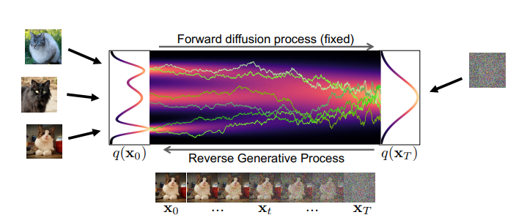
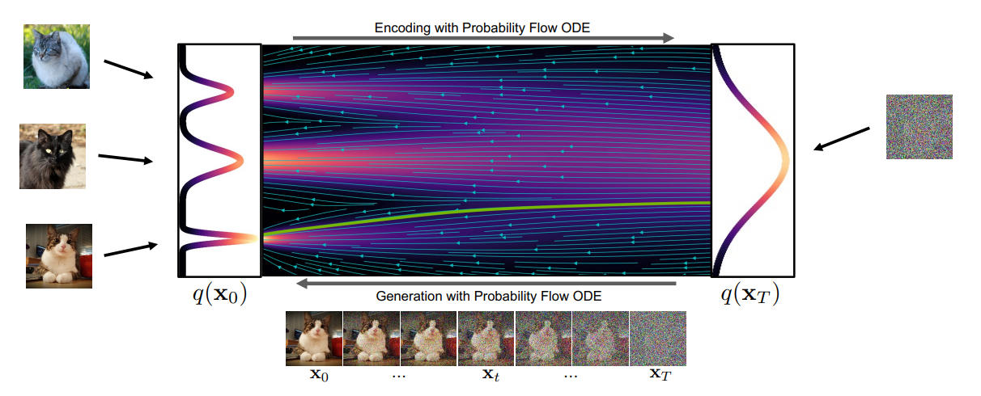

SDE <-> ODE
5. Relation to Diffusion Models
As we discussed in the earlier presentation (see Week 5: DDIM & Score Matching), matching the marginals allows an SDE to be converted into an equivalent ODE.
$$dx\left(t\right)=[−\frac{1}{2}β\left(t\right)x\left(t\right)−\frac{1}{2}β\left(t\right)∇_{x}\log{q_{t}\left(x\left(t\right)\right)}]dt$$
This leads to same $q_{t}\left(x\left(t\right)\right)$ with Reverse SDE

Slide 28
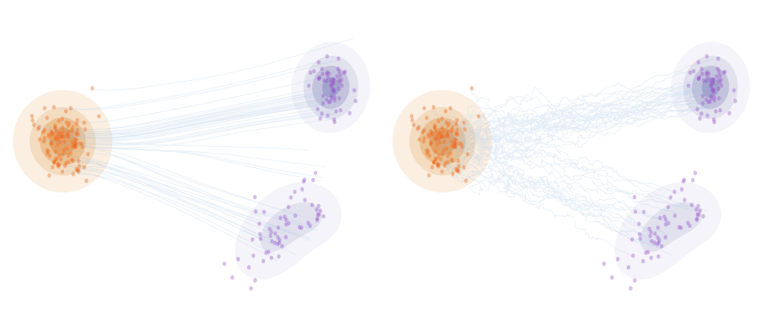
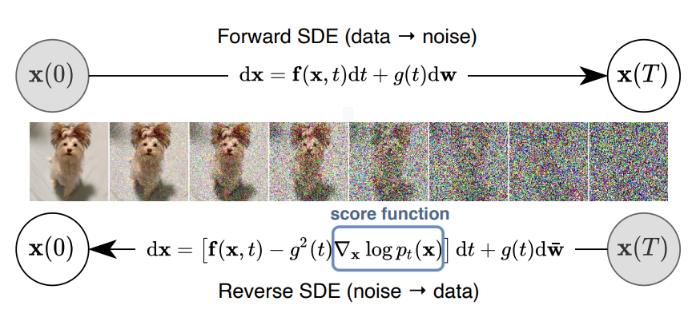


DDPM (Stochastic) = Rectified Flow + Langevin dynamics
5. Relation to Diffusion Models
Flow:
$\frac{dz_{t}}{dt}$ = $v_{θ}\left(z, t\right)$
Convert to SDE:
$\frac{dz_{t}}{dt}$ = $v_{θ}\left(z, t\right)$ + $σ_{t}^{2}∇\log{p_{t}}\left(Z_{t}\right)+ \sqrt{2}σ_{t}dW_{t}$
Score function
Wiener process
Langevin dynamics
Recall: Diffusion as SDE
qiang liu., “Flowing Through Continuous-Time Generative Models: A Clear and Systematic Tour”, ICML Tutorial 2025.

Slide 29
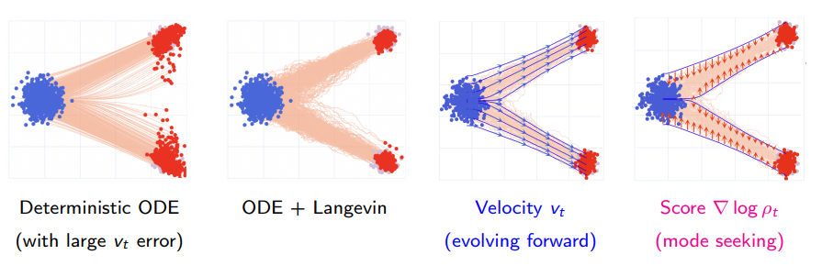
DDPM (Stochastic) = Rectified Flow + Langevin dynamics
5. Relation to Diffusion Models
What is the purpose of adding noise to an otherwise clean straight path, especially when noise seems to slow down fast sampling?
Solving the ODE alone may introduce approximation errors that accumulate over steps. Adding a Langevin term acts as an error corrector, regulating the trajectory and keeping it aligned with the target distribution.
qiang liu., “Flowing Through Continuous-Time Generative Models: A Clear and Systematic Tour”, ICML Tutorial 2025.

Slide 30
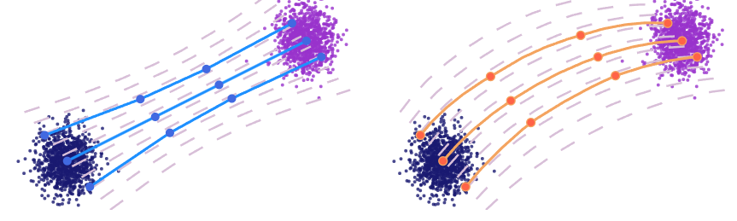
DDIM (Deterministic) = Rectified Flow
5. Relation to Diffusion Models
Recall: DDIM is already an ODE version of DDPM which is deterministic
Then, could DDIM be regarded as a flow?
DDIM inference can be seen as applying a curved Euler method to curved interpolation trajectories.
This is equivalent to applying the vanilla straight Euler method to a rectified flow
qiang liu., “Flowing Through Continuous-Time Generative Models: A Clear and Systematic Tour”, ICML Tutorial 2025.

Slide 31



